Slide 1
Natural Language Processing
Week 4

Slide 2
Good evening, everyone. Welcome to the live session.
Today, we will be practicing problems from the current week’s content.
We will wait 5 minutes for everyone to join in and start at 7:05 pm.

Slide 3
Question 1: Baum-Welch algorithm is an example of -
a. Forward-backward algorithm
b. Special case of the Expectation-maximization algorithm
c. Both A and B
c. None

Slide 4
Solution
Question 1: Baum-Welch algorithm is an example of -
a. Forward-backward algorithm
b. Special case of the Expectation-maximization algorithm
c. Both A and B
c. None
Answer: C

Slide 5
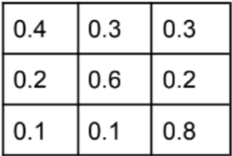
Question 2: Once a day (e.g. at noon), the weather is observed as one of state 1: rainy, state 2:cloudy, state 3: sunny. The state transition probabilities are :
Given that the weather on day 1 (t = 1) is sunny (state 3), what is the probability that the weather for the next 7 days will be “sun-sun-rain-rain-sun-cloudy-sun”?
a. 1.54 * 10-4
b. 8.9 * 10-2
c. 7.1 * 10-7
d. 2.5 * 10-10

Slide 6
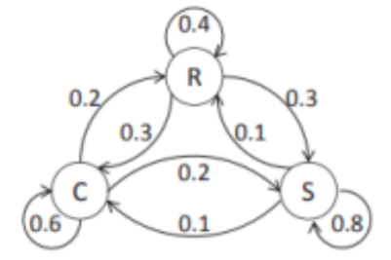
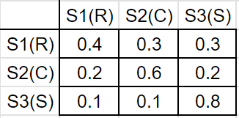
Solution
State 1(S1) = rainy, State 2(S2) = cloudy, State 3(S3): sunny
Given: Weather on day 1 (t = 1) is sunny (state 3).
Therefore, P(S3|start) = 1, P(S1|start) = 0, P(S2|start) = 0
O = {sun, sun, sun, rainy, rainy, sun, cloudy, sun}
O = {S3, S3, S3, S1, S1, S3, S2, S3}

Slide 7
Solution
O = {S3, S3, S3, S1, S1, S3, S2, S3}
P(O | Model)
= P(S3, S3, S3, S1, S1, S3, S2, S3 | Model)
= P(S3|start) P(S3|S3) P(S3|S3) P(S1|S3) P(S1|S1) P(S3|S1) P(S2| S3) P(S3|S2)
= P(S3|start) · a33 · a33 · a31 · a11 · a13 · a32 · a23
= (1)(0.8)(0.8)(0.1)(0.4)(0.3)(0.1)(0.2)
= 1.536 × 10-4
Answer: A

Slide 8
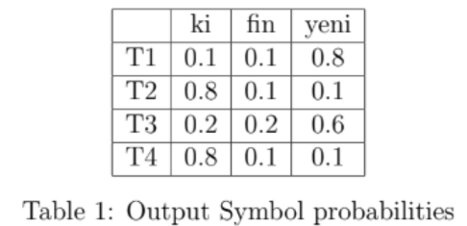
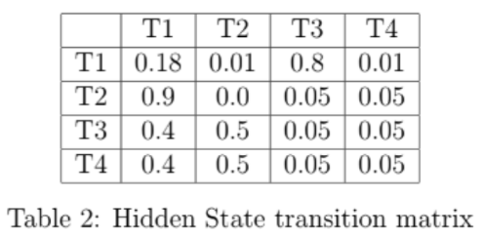
Question 3: We are given the sequence “ki fin yeni!”. Possible POS tags are {T1,T2, T3, T4}. Assume all POS tags are equally likely to be at the starting of a sequence.
Calculate P(x1 = “ki”, x2 = “fin”, y1 = “T1”, y2 = “T2”).
a. 0.000025
b. 0.0001
c. 0.0025
d. None of the above

Slide 9
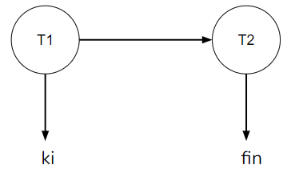
Solution
Solution: Assume all POS tags are equally likely to be at the starting of a sequence. Possible POS tags are {T1,T2, T3, T4}
Initial probabilities: P(T1|start) = 1/4, P(T2|start) = 1/4, P(T3|start) = 1/4, P(T4|start) = ¼
P(x1 = “ki”, x2 = “fin”, y1 = T1, y2 = T2)
= P(T1|start) P(“ki”|T1) P(T2|T1) P(“fin”|T2)
= 0.25 * 0.1 * 0.01 * 0.1
= 0.000025
Answer: A

Slide 10
Question 4: Let us define an HMM Model with K classes for hidden states and T data points as observations. The dataset is defined as X = {x1, x2, . . . , xT } and the corresponding hidden states are Z = {z1, z2, . . . , zT }. Please note that each xi is an observed variable and each zi can belong to one of classes for hidden state. What will be the size of the state transition matrix, and the emission matrix, respectively for this example.
a. K × K, K × T
b. K × T, K × T
c. K × K, K × K
d. K × T, K × K

Slide 11
Solution
Answer: A
Solution: Since there are K hidden states, the state transition matrix will be of size
K × K. The emission matrix will be of size K × T, as it defines the probability of
emitting an observed state from a hidden state.

Slide 12
Question 5: You are building a model distribution for an infinite stream of word tokens. You know that the source of this stream has a vocabulary of size 1000. Out of these 1000 words you know of 100 words to be stop words each of which has a probability of 0.0019. With only this knowledge what is the maximum possible entropy of the modelled distribution. (Use log base 10 for entropy calculation)
a. 5.079
b. 0
c. 2.984
d. 12.871

Slide 13
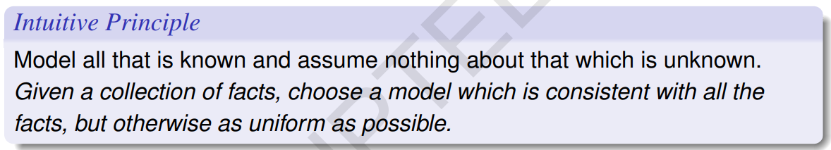
Solution
Answer: C
Solution: There are 100 stopwords with each having an occurrence probability of 0.0019. Hence, P(Stopwords) = 100 ∗ 0.0019 = 0.19
P(non − stopwords) = 1 − 0.19 = 0.81
For maximum entropy, the remaining probability should be uniformly distributed.
For every non-stopword w, P(w) = 0.81/(1000 − 100) = 0.81/900 = 0.0009.
Finally, the value of the entropy would be,
H = E(log(1/p)) = −100(0.0019 ∗ log(0.0019)) − 900(0.0009 log(0.0009)) = −2.9841

Slide 14
Question 6: For an HMM model with N hidden states, V observable states, what are the dimensions of parameter matrices A,B and π? A: Transition matrix, B: Emission matrix, π: Initial Probability matrix.
a. N × V, N × V, N × N
b. N × N, N × V, N × 1
c. N × N, V × V, N × 1
d. N × V, V × V, V × 1

Slide 15
Solution
Answer: B
Solution:
We are given a HMM model with N hidden states, V observable states
Matrix A contains all the transition probabilities and have dimension N × N.
Matrix B contains all the emission probabilities and dimension N × V .
π contains initial probability for all hidden states and have dimension N × 1.

Slide 16
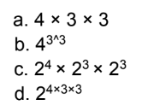
Question 7: Suppose you have the input sentence “Death Note is a great anime”. And you know the possible tags each of the words in the sentence can take.
Death: NN, NNS, NNP, NNPS
Note: VB, VBD, VBZ
is: VB
a: DT
great: ADJ
anime: NN, NNS, NNP
How many hidden state sequences are possible for the above sentence and States?

Slide 17
Solution
Answer: A
Solution: Each possible hidden sequence can take only one POS tag for each of the
words. Hence the total possibility will be a product of the number of candidates for
each word.
Number of possible hidden state sequences = 4 * 3 * 1 * 1 * 1 * 3

Slide 18
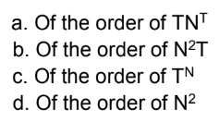
Question 8: In Hidden Markov Models or HMMs, the joint likelihood of an observed sequence O with a hidden state sequence Q, is written as P(O, Q; θ). In many applications, like POS tagging, one is interested in finding the hidden state sequence Q, for a given observation sequence, that maximizes P(O, Q; θ). What is the time required to compute the most likely Q using an exhaustive search? The required notations are, N: possible number of hidden states, T: length of the observed sequence.

Slide 19

Solution
Answer: A

